Slide 1
Analytics Immersion Workshop
Train the Trainer
Alex Karasek / CSA, Data & AI
Brian Hitney / CSA, Data & AI

Slide 2
Agenda
~Time (ET)
1pm | Intros, Content Overview
1:30pm | Whiteboarding breakout (room TBD)
2:00pm | Whiteboarding presentation main room
2:15pm | Lab start
3:45pm | WhatTheHack content discussion
4:00pm | End

Slide 3
Resources
My talknotes: https://aka.ms/talknotes
Click the “Fall, 2020 Analytics Immersion Workshop TTT”
Main content:
https://partner.microsoft.com/en-us/asset/collection/analytics-in-a-day#/
Recording (1 hour) of this session: https://aka.ms/analyticsimmersion
Main meeting room: https://aka.ms/analyticsmainroom
Breakout Room 1: https://aka.ms/analyticsbreakoutroom
Lab signup: https://bit.ly/3nYfjt9
Use activation code: ACTIVATE9278

Slide 4
About TTT Events

Slide 5
What is a TTT (Train the Trainer)
Designed to get you – the partner or organization – familiar with:
Analytics in a Day content
Typical requirements
Best practices, learnings, and resources
TTTs are not designed to teach you about Synapse and Analytics.
TTTs are designed to ensure you have a successful event!
Suggest a format
Show you the content
Walk through the labs

Slide 6
Content Overview

Slide 7
Original Schedule
Time | Content
9:00 – 10:00 | Presentation – The Heart of Analytics
10:00 – 11:00 | Optimizing analytics with Azure Synapse
11:00 – 11:15 | Power BI and Azure Synapse
<break>
11:30 – 1:00 | Hands on lab

Slide 8
Modified Schedule
Time | Content
9:00 – 10:30 | Presentation – The Heart of Analytics / Azure Synapse Overview
11:00 – 11:30 | Team breakout: Architectural whiteboarding
11:30 – 1:00 | Hands on lab
Added Architectural whiteboarding team breakout

Slide 9
Full Day Schedule
Time | Content
9:00 – 10:00 | Presentation – The Heart of Analytics
10:00 – 11:00 | Optimizing analytics with Azure Synapse
11:00 – 11:30 | Power BI and Azure Synapse
<break>
12:00 – 1:00 | Team breakout: Architectural whiteboarding
1:30 – 4:00 | Hands on Lab
Keeps all presentation material
Adds design session breakout
Extends lab time

Slide 10
Multi-day Schedule
Day 1
Time | Content
9:00 – 10:00 | Presentation – The Heart of Analytics
10:00 – 11:00 | Optimizing analytics with Azure Synapse
11:00 – 11:30 | Power BI and Azure Synapse
<break>
12:00 – 1:00 | Team breakout: Architectural whiteboarding
1:30 – 4:00 | WhatTheHack – This Old Data Warehouse
Day 2
Time | Content
9:00 – 4:00 | WhatTheHack – This Old Data Warehouse (continued)

Slide 11
Azure Synapse Analytics
Overview & Value Proposition
(This section removed for size – will be in final deck)

Slide 12
Hands-on Options

Slide 13
Analytics in a Day Content HOL
Soliance guided/provisioned HOL:
https://github.com/solliancenet/azure-synapse-analytics-day
Lab environments currently available for provisioning, greatly reducing setup time and support/proctoring needs. However, environments must be requested ahead of time for each student. Refer to the document on the content site for information on requesting environments.
For today’s Lab: https://bit.ly/3nYfjt9
Access Code: ACTIVATE9278

Slide 14
Microsoft OpenHack
OpenHack for Modern Data Warehousing
https://openhack.microsoft.com/
https://www.microsoftevents.com/profile/form/index.cfm?PKformID=0x11380507abcd
Sept 29 – Oct 1, 2020 (check for upcoming/new events)
This OpenHack enables attendees to develop, implement, and operationalize ETL pipelines for a multi-source data warehouse solution on Microsoft Azure. This OpenHack simulates a real-world scenario where an online DVD company’s data is coming in from a mess of disparate sources but needs to be stored in a single location, made sense of, and then used to feed a wide variety of downstream systems. During the “hacking” attendees will focus on 1. systematically ingesting and securing data from multiple sources and, then, 2. transforming data to.fit business’s required schema and monitor dataflow with levels of DevOps testing. By the end of the OpenHack, attendees will have built out a technical solution that is a fully operating Modern Data Warehouse with corresponding CI/CD pipeline that takes into account data management – which meets top-quality data consumption requirements, like reliability, scalability, and maintainability.

Slide 15
What The Hack: This Old Data Warehouse
Uses the WWI (Wide World Importers) scenario from the design session, located here:
https://github.com/microsoft/WhatTheHack/tree/master/019-ThisOldDataWarehouse
What the Hack (WTH) are hands-on, challenge-based hackathons that can be hosted in-person or virtually. This hack consists of 5 challenges designed to simulate a real-world situation: migrating a solution to Azure Synapse, leveraging real time data, taking advantage of modern ELT tools and integrating them into reporting.
The length of the event can determine the ‘goalpost’ for the number of challenges to complete; challenges can be continued to be worked on after the event.

Slide 16
Architectural Breakout

Slide 17
Architectural Whiteboarding
WWI (Wide World Importers) is a wholesale novelty goods importer and distributor operating in the San Francisco bay area. As a wholesaler, WWI’s customers are mostly companies who resell to individuals. These include specialty stores, supermarkets, tourist attraction shops, etc. All of WWI’s customers are located in the United States.
WWI’s architecture consists of two on-premises databases: an OLTP for online/transaction processing, and a data warehouse for analytics.
WWI wants to modernize their data warehouse in phases. The first stage will be to scale-out their existing data warehouse horizontally. The data warehouse migration will be from their on-premises WWI Data Warehouse to Azure Synapse Analytics. They like to reuse their existing ETL code (SSIS) and leave their source systems as-is (no migration).
For the second phase, WWI would like to re-engineer their data warehouse to accommodate larger data sets, semistructured data (CSV/JSON), and real-time ingestion of data.
For the third phase, WWI would like to rewrite this process entirely from SSIS and is looking for recommendations on how to implement.

Slide 18
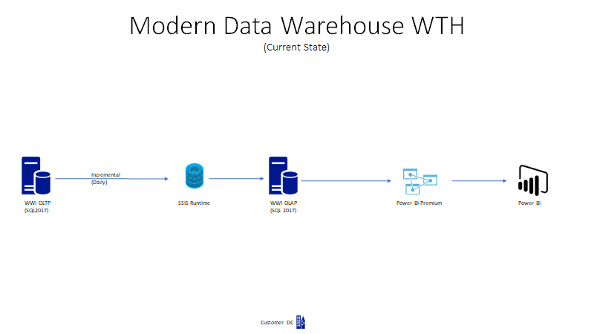
Architectural Whiteboarding
Phase 0: Current Design

Slide 19
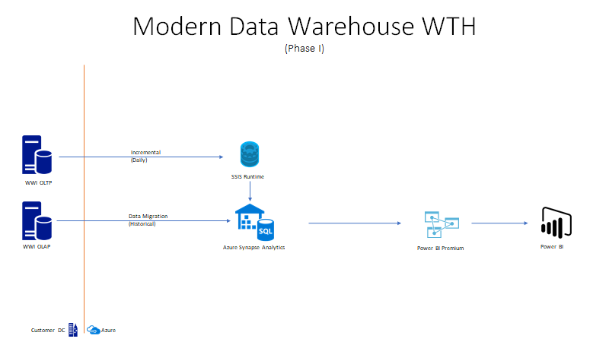
Architectural Whiteboarding
Phase 1: Scale to Azure Synapse

Slide 20
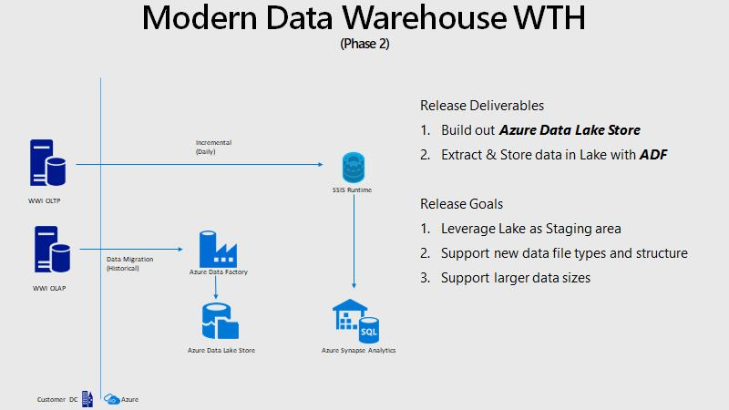
Architectural Whiteboarding
Phase 2: Evolve the Data Lake

Slide 21
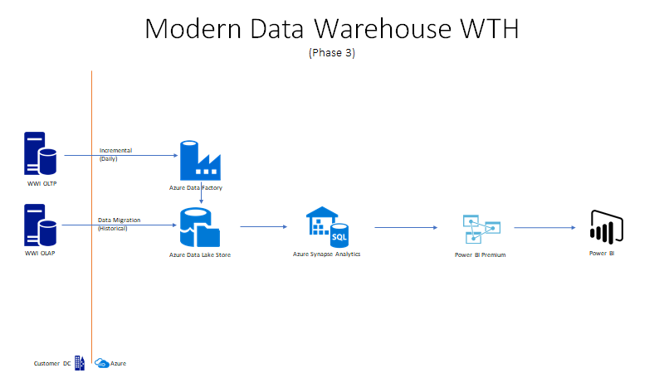
Architectural Whiteboarding
Phase 3: Redesign import process

Slide 22
Q&A
Go to https://aka.ms/OCP-ImmersionWorkshops to learn more about this program and get your questions answered This group is part of the US Partner Community on Yammer. You will need to request to join this external network if you have not been there before.

Slide 23
Before you go
Notes:
Before we wrap, let me share some final though.
First, your feedback about today’s session is priceless. It enable the Microsoft OCP team ensure we are adding value to you—our most valuable MSUS Partner—by providing the resources to build Azure-focused practices.
Second, we encourage you to join the MSUS Partner Yammer Community to engage with +20k members via groups tailored to your needs.
Third, engage with the Cloud Enablement Desk or with Cloud Solution Architects to explore how to build solutions using Azure to solve the most critical customers’ challenges.

